Slide 2
Side-meeting IETF-124 November 05th, 2024

Slide 3
Agenda
SONiC Overview High-Level Architecture Routing Workgroup Update Virtual Dataplane Workgroup Update Closure

Slide 4
SONiC Overview

Slide 5



















































SONiC/SAI Community and Partners
Merchant Silicon
Switch Platform
Adoption
System/Service

Slide 6
Goals of SONiC
Disaggregation with
SONiC
Faster
Technology
Evolution
Open &
Modular
Software
Reduce
Operational
Burden
Choices of
Vendors
& Platforms
Notes:
And why are we doing SONiC? What are the common goals across so many industry partners in the sonic community?

Slide 7
The Journey so far
Containerized
Kubernetes Mgmt.
DASH
Fast reboot
Streaming Telemetry
Warm Reboot
Restful API
EVPN
PINS
RDMA
VxLan
Virtualization
IPv6
Basic L2/L3
configDB
2016
2017
2018
2019
2020
2021
2022
40G
100G
1 G Mgmt. Switch
Smart Cable
ARM support
Chassis

Slide 8
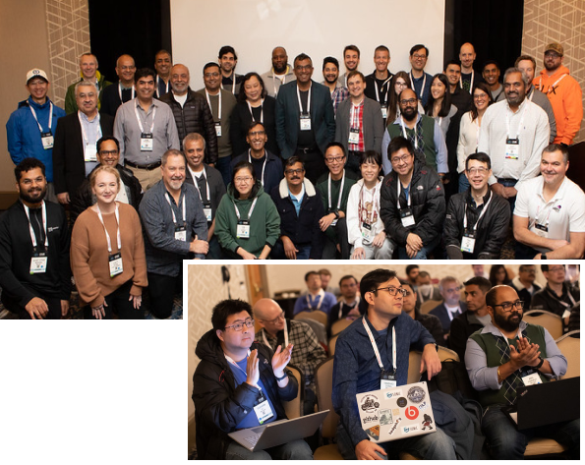
SONiC - Year End Review
380K+
4K
social media reach
active contributors
27
6
SONiC members
2024 in-person events
SONiC Workshop at
OCP Global Summit
SONiC Workshop India
SONiC Workshop Japan
SONiC China Forum
SONiC Workshop at OSS EU
SONiC Workshop at
ONE Summit
2024
April
May
June
September
October

Slide 9
Workgroups Highlights
AI Workgroup
Smart Switch Workgroup
OTN Workgroup
Routing Workgroup
Fabric Workstream
Topology (led by Nvidia, Dell, BRCM, Marvell)
Routing (led by Nvidia, Dell, BRCM)
Traffic Management Workstream
Congestion (led by Nvidia)
PFC (led by BRCM)
Telemetry Workstream
(All workstreams finished first round investigation)
Platform Architecture HLD for SmartSwitch completed
DPU database design completed
Midplane/PCIE architecture completed
IP address assignment design completion
gNMI design from NPU to DPU
DPU High-availability design
NPU-DPU Health probing design using BFD
OTN services (OTSS, Syncd-OT, OTAI) HLDs have been reviewed with PR to SONiC.
OTN virtual platform and KVM device have been supported in SONiC-OTN branch.
OTN enhancement on sonic-mgmt-common HLD has been reviewed with PR to SONiC.
Usecases: Phoenix Wing (SRv6), VxLAN-DC, Route Optimization, RIB/FIB, ARS
Enhanced sonic-mgmt vsonic test infra from single box testing to multi-node topology testing.
The phoenix wing platform test plan PR and the test infra enhancement code PR are raised.
Spytest test plan is working in progress between Alibaba team and Cisco team.

Slide 10
High-Level Architecture
Patrice Brissette, Cisco

Slide 11










SONiC: Software for Open Networking in the Cloud
1ST party
Rich management capabilities
Telemetry
SNMP
BGP
Utility
Mgmt
Container for serviceability and portability
Switch State Service
Application State Decoupling
Hello
Platform Management API
Switch Abstraction Interface
Platform/ASIC Independence
PSU
FAN
XCVR
Sensor
LED
مرحبا
你好
नमस्ते
Bonjour
Aloha
Notes:
What is SONiC

Slide 12
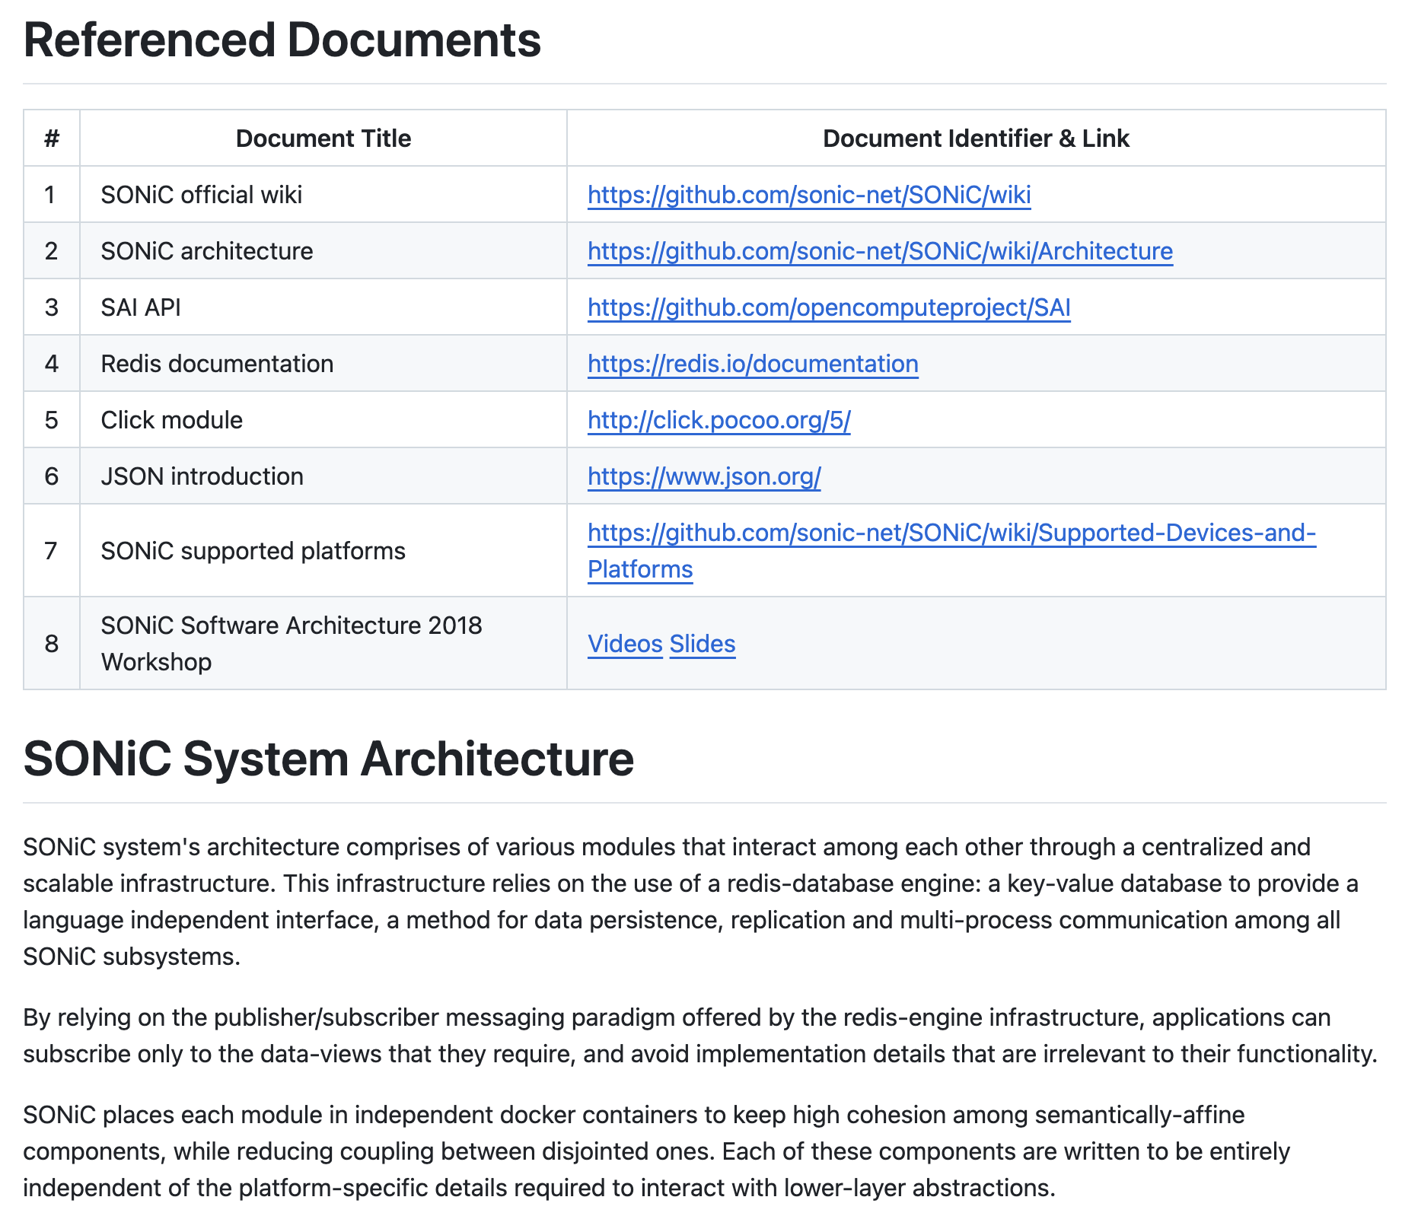
High-Level Architecture
Documents

Slide 13
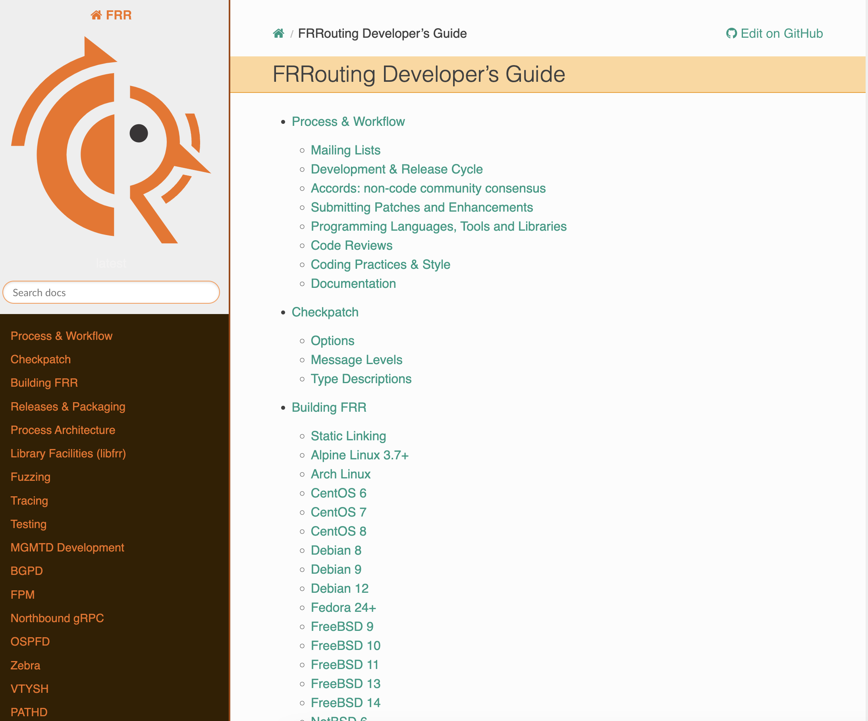
High-Level Architecture
FRRouting

Slide 14
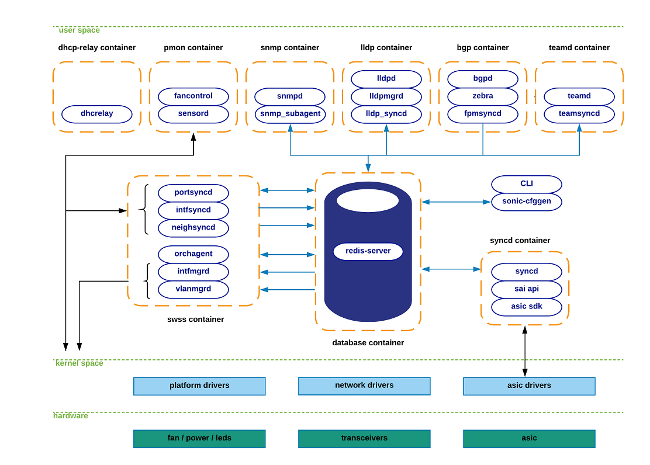
High-Level Architecture
SONiC Overview

Slide 15
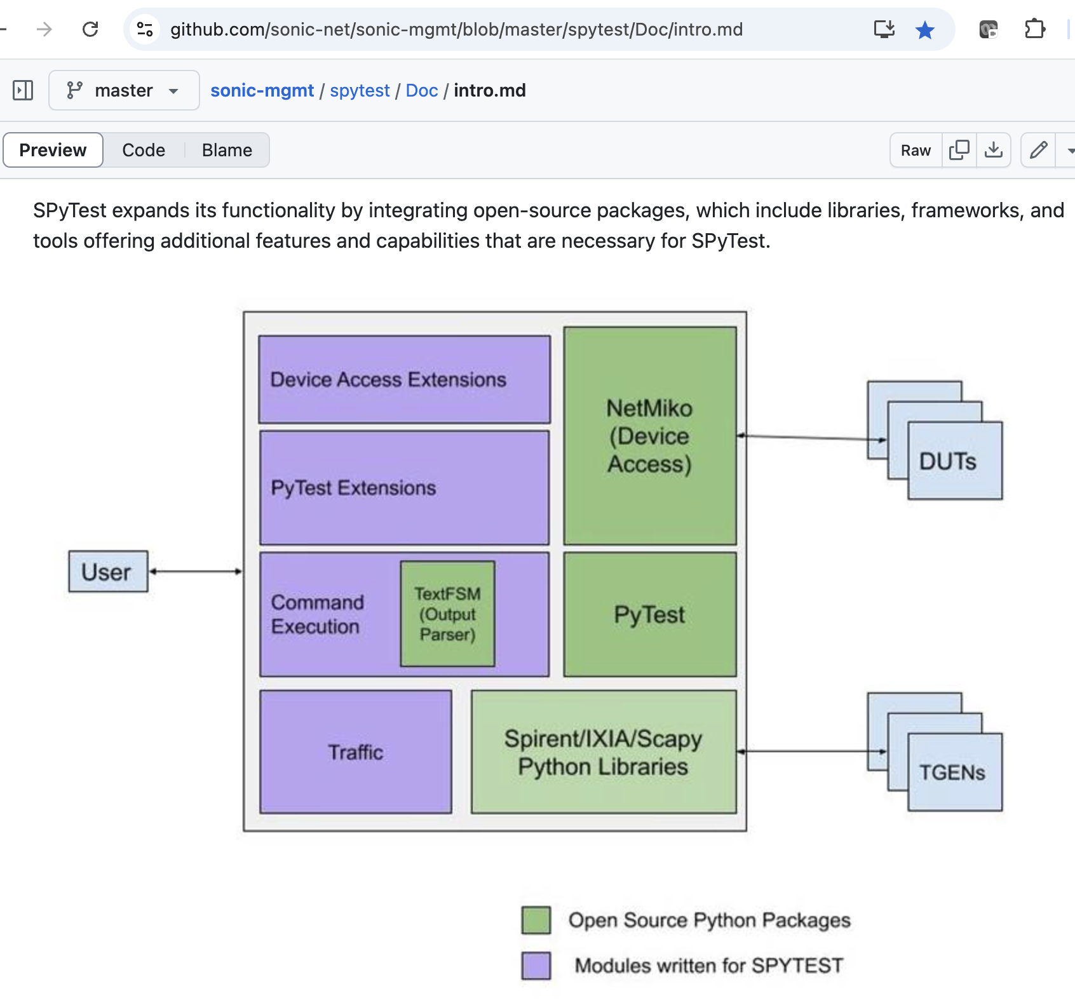
High-Level Architecture
Spytest

Slide 16
Useful Links
https://github.com/sonic-net/ https://github.com/sonic-net/SONiC/wiki https://github.com/sonic-net/SONiC/wiki/Architecture https://github.com/opencomputeproject/SAI https://frrouting.org/ https://docs.frrouting.org/projects/dev-guide/en/latest/index.html#

Slide 17
Routing Workgroup Update
Patrice Brissette, Cisco

Slide 18
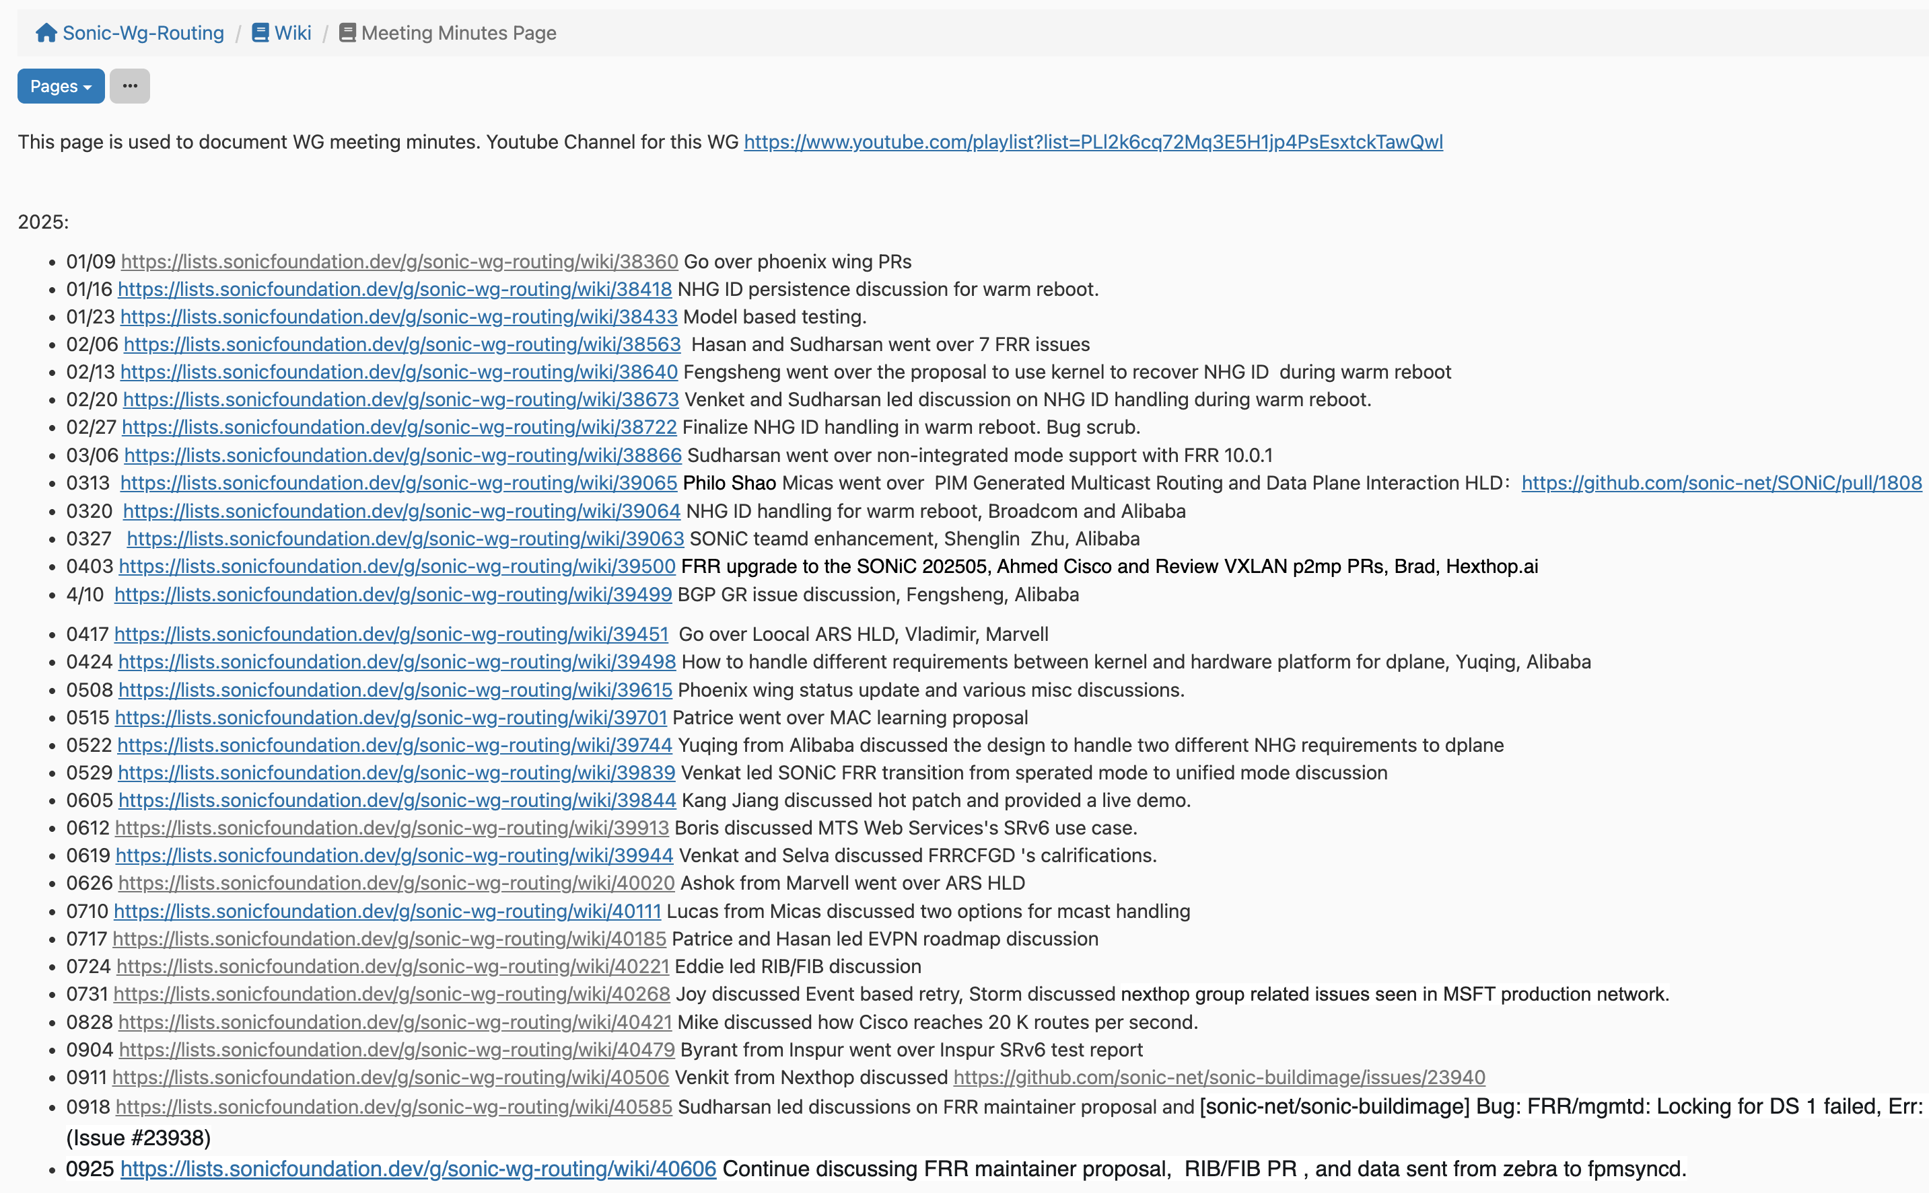
Focus Areas and Weekly Discussions
Routing infra related Enhancements and SRv6 related features.
VxLAN Multi-homing
Route download optimization
Adaptive Routing and Switching
SONiC-FRR maintenance
Any routing / forwarding related topics

Slide 19
VxLAN MH Concept
L3 routing
RT-2 (IP), RT-5
TOR
TOR
BD core
L3VNI
BD core
L3SVI
(no IP)
L3SVI
(no IP)
VRF
VRF
L2SVI
(w/ IP)
Subnet-Stretch
RT-2 (MAC)
L2SVI
(w/ IP)
BD access
L2VNI
BD access
interface
RT-1 (MW)
RT-4 (ES)
RT-2 (ARP/ND sync)
interface
Host

Slide 20
VxLAN MH Content
Single-Homed
Multi-Homed
VXLAN encapsulation
VXLAN decapsulation
IPv6 and IPv4 VTEP support
Symmetric IRB (L3VNI)
Tunnel Bridge Ports (L2VNI)
Static MAC
BUM traffic
Multiple tunnel maps
VRF per VNI (L3VNI)
VLAN per VNI (L2VNI)
MAC Mobility
IP Mobility
Static Anycast Gateway
Support all-active redundancy mode
Support following features on EVPN MH:
BUM traffic handling
Symmetric IRB
Static Anycast Gateway
BGP over EVPN Multihomed Ethernet-Segment
MAC and IP mobility
Support for Ethernet Segment IDs types
System-MAC based
Operator Configured
Duplicate-Address-Detection

Slide 21
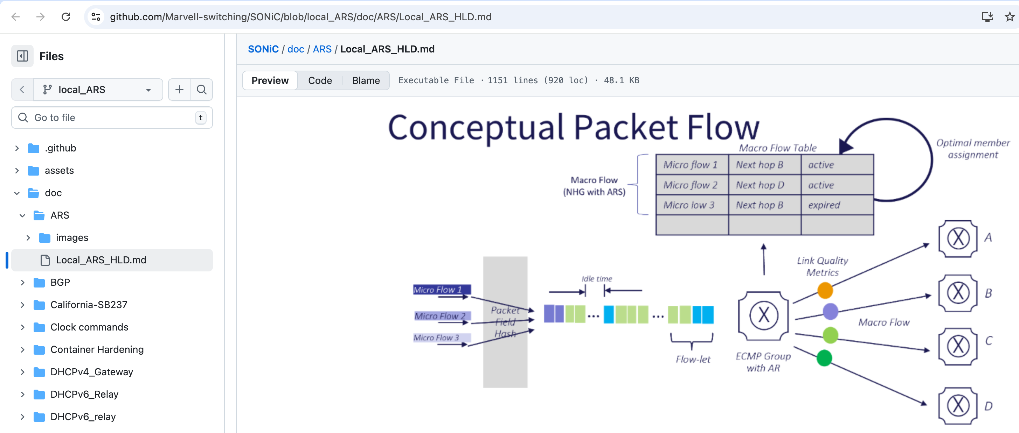
Adaptive Routing Switching

Slide 22
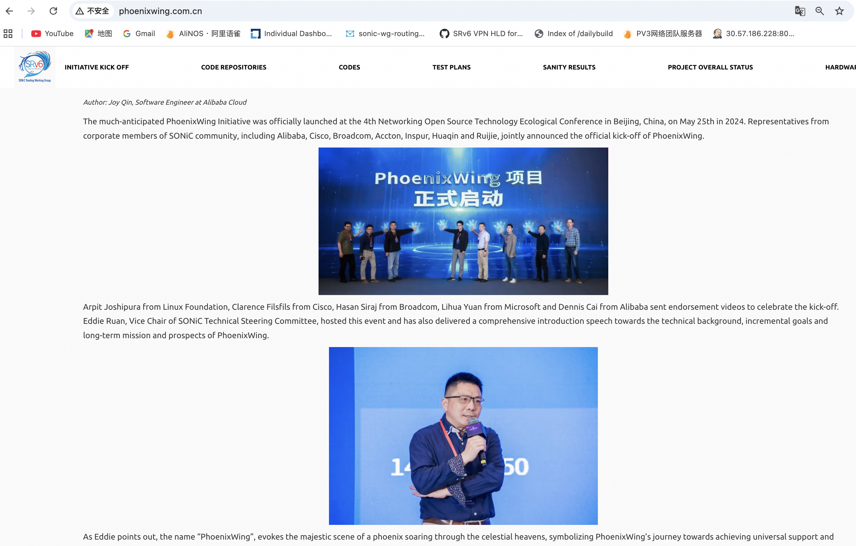
Phoenix Wing Initiative
Short Term Goals:
Verify the deployment readiness of SRv6 solutions via using the SONiC 202411 release on participated hardware devices
Long term goals:
Promote more SONiC based SRv6 deployments, complete the testing tool set for the SRv6 solutions
Add SRv6 into SONiC interop lab.
Provide SONiC SRv6 standardized test cases, set expected test results for SRv6 solutions.
Offer verfied SRv6 solution deployment scenario cases.
Launched on 05/25/2024 in Beijing, China

Slide 23
Route Download Optimization
2nd wave: analysis and results
Async mode |  |  | On |  |  |  | On | On | On | On
Multi db |  |  |  | On | On | On | On | On | On | On
Batch / bulk sizes |  |  |  |  | On | On |  | On | On | On
No APPL_STATE_DB population |  | On |  |  | On | On | On | On | On | On
Ring buffer |  |  |  |  | On | On | On | On | On | On
Zmq for ConsumerStateTable |  |  |  |  | On | On |  | On | On | On
No logs |  |  |  |  | On | On |  | On | On | On
Use nexthop groups (even for single nbr) |  |  |  |  |  |  |  |  |  | On
Sort SAI route bulk |  |  |  |  | On | On |  | On | On | On
Bypass saimeta::Meta for bulk operations |  |  |  |  | On | On |  | On | On | On
No APPL_DB and APPL_ASIC_DB populations |  |  |  |  |  | On |  |  | On | On
Total speed (1K routes /sec ) | 2 | 4 | 2.9 | 3.6 | 12 | 13 | 14 | 18.5 | 20.6 | 21
From 2K routes/sec to 21K routes/sec

Slide 24
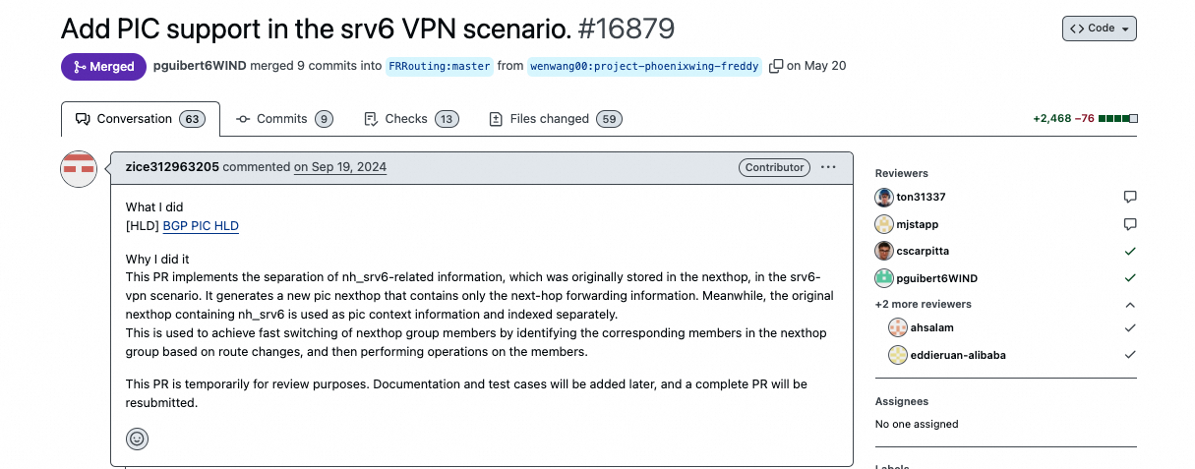
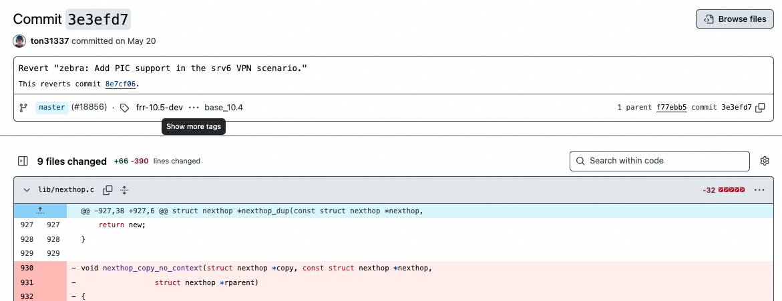
Concerns from FRR community
Three problems to be solved in Phoenix Wing
Better Convergence via using Nexthop Group ID
Prefix Independent Convergence (PIC)
SRv6 VPN’s SONiC chain is different from Linux Kernel Chain
FRR team’s concern:
Zebra’s complexity is growing unmanageable.
Recommendation:
Simplify via 'Divide and Conquer’, a.k.a. RIB/FIB separation.

Slide 25
Routing Stack Building Blocks
Common NOS
SONiC
Update topology database
BGP
RIB
PI FIB
PD FIB
HAL
HW
FRRouting BGP
Compute optimal path
FRRouting Zebra
Converting RIB to FIB
???
Download to HW FIB
SONiC Orchagent
Hardware Abstraction Layer
SONiC SAI
Forwarding chain with
SONiC SDK

Slide 26
High Level View
zebra
zebra
RIB with implicit FIB
RIB
dplane_fpm_sonic.so
dplane_fpm_sonic.so
fpmsyncd
fpmsyncd
SONiC FIB
FIB
APPDB
APPDB
orchagent
orchagent
Before
After

Slide 27
Virtual Dataplane Workgroup Update
Murali Venkat, Cisco
Yue Gao, Cisco

Slide 28
Agenda
SONiC-VPP is a platform under SONiC that supports VPP data plane SONiC-VPP background, features and goals Architecture DC Features(new): Vxlan, SRv6 vSmartswitch with SONiC-VPP & BmV2
SONiC-VPP Testing at Azure Community Collaborations and usage
Call to action
Notes:
Why are we doing all this ? What problems are we solving - > Enable a platform for Testing with Traffic on a real dataplane
At Cisco – 2 Complementary solutions – we are doing a open solution and S1 solution …

Slide 29

Why SONiC-VPP ?
SONiC needs a compelling software forwarding engine, VPP
Is a real forwarding plane
Is feature rich & performant
Is open sourced and community driven
Runs on commodity hardware
Empowers ANYONE to complete proto to production worthy feature, extensible
No vendor dependency
A new platform for real deployment/usecases over time
Usage Today:
SONiC Development vehicle for DataCenter Testing
In Future:
Cloud Gateways
CellSite router
UPF/Fwa
Stateful Services (Lawful Intercept, IPFix/NF, Fw, LB, Cg-NAT, IPsec etc.)

Slide 30
VPP – Vector Packet Processor
Extensible and Flexible modular design
Implement as a directed graph of nodes
Extensible with plugins, plugins are equal citizens.
Fully featured dataplane
L2: VLan, Q-in-Q, Bridge Domains, LLDP .
L3: IPv4, GRE, VXLAN, DHCP, IPSEC …
L3: IPv6, Discovery, Segment Routing …
L4: TCP, UDP …
CP: API, CLI, IKEv2 …
Performance
V4: 33.5Mpps (22.5Gbps) per core with 64-bytes packets (PDR)
IPSEC: 3.25Mpps (41.5Gbps) per core with IMIX traffic (PDR)
Scalable FIB: supporting millions of entries
0 packet drops, ~15µs latency
Netconf/Yang
REST
...
Management Agent
Packet Processing: VPP
Network I/O
Notes:
DPDK for fast I/O
ISA: SSE, AVX, AVX2, NEON ..
IPC: Batching, no mode switching, no context switches, non-blocking
Multi-core: Cache and memory efficient

Slide 31
SONiC-VPP Features
Interface/Sub-interface and Stats
L2 Bridging
L3 IPv4/IPv6 – VRF, Route programming
IPV4/IPV6
IPV4 Multipath Routing (ECMP)
BGP
Single-Hop/Multi-hop BFD
LLDP
ACLs
LAG/LACP/PortChannel
VxLAN
SRv6 - Support uN, uA, uDT4/6, H-Encaps and SRv6 policy
Work Group focus:
• Infra related enhancements and features
• Increase test coverage
202505
202511
202605
SONiC
VPP
202502
202506
202510

Slide 32
SONiC VPP High Level Components
SONiC VPP Container/KVM
Streamlined SONiC build on x86
GNMI and REST for all configs including FRR (FRR BGP)
CLI from existing sonic-cli/vpp cli/frr cli – for Manageability & Debuggability
SONIC Control Plane
IS-IS
MPLS
QOS
RESTCONF
SNMPv3
Telemetry
Logging Infra
SONiC VPP SAI
VPP binary api
VPP
DPDK
Linux Kernel
Compute/Networking Hardware

Slide 33
SONiC VPP Architecture
CLI
GNMI
REST
VM or Container
SONiC
APPL/
CONFIG
platform.json
Application Tables
CONFIG Tables
hwsku.json
SWSS
VPP platform service
syncd
ASIC_DB
libsaivpp.so
Generates
Host Path
IPC
Binary API
VPP workers
startup.conf
VPP Masters
Netlink plugin
Linux CP plugin
VPP
Base OS (Choice of Linux Distro)
Board Support Package / Networking Hardware
CPU CLUSTER
CPU CLUSTER
CPU CLUSTER
CPU CLUSTER
Notes:
Single NPU – could be extended to multiple NPUs​
Up to 32 interfaces – could be extended with different profiles​
10 CPU cores​
VPP control plane:1​
VPP data plane: 3 and can be adjusted based on BW requirements​ to scale up or down – depending on usecase (testing or production)
SONiC: 6​
8G memory​
SONiC-VPP can be deployed in a topology with other physical switchesand/or virtual switches.​
Container deployment is also possible
Platform service generates startup.conf

Slide 34
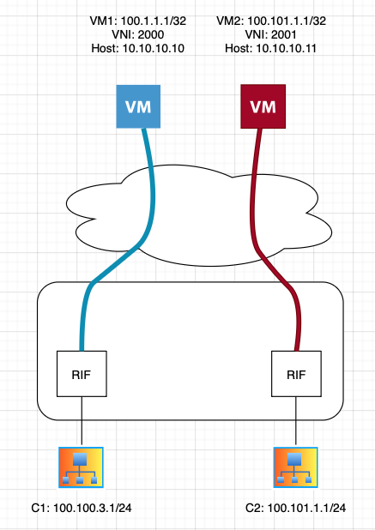
SONiC VPP – VNET VxLAN
Support IPv4 and IPv6 VxLAN Encapsulation and Decapsulation for VNET Peering
Support multi-hop BFD monitoring for route protection
VxLAN ECMP path and primary/backup path

Slide 35
SONiC-VPP SRv6
Supported Behavior | Description
uN | NEXT-CSID (Compressed SID) End behavior with a pseudocode of shift-and-lookup
uA | NEXT-CSID End.X behavior with a pseudocode of shift-and-xconnect (to a specified interface)
SRv6 SID List + Policy | List of segment IDs (SIDs) to be used with traffic steering. Multiple SID lists can be used in a single policy for traffic steering, and both encap and insert are supported (only encap is supported by FRR, however).
Prefix steering over a SID List | Allows for traffic engineering by routing traffic over a pre-defined policy / SID list.
uDT4, uDT6 | Endpoint with decapsulation and IPv4/6 table lookup (IPv6-L3VPN - equivalent to per-VRF VPN label).
Notes:
PhoenixWing/Srv6/TE cases can be evaluated in vendor agnostic fashion

Slide 36
Deployment
SONiC-VPP deployed in a VM
Single NPU – could be extended to multiple NPUs
Up to 32 interfaces – could be extended with different profiles
10 CPU cores
VPP control plane:1
VPP data plane: 3 and can be adjusted based on BW requirements
SONiC: 6
8G memory
SONiC-VPP can be deployed in a topology with other physical switches and/or virtual switches.
Container deployment is also possible

Slide 37
vSmartSwitch – SONiC-VPP + Bmv2
A sandbox for smartswitch development & test with all open source components
Solution leverages SONiC-VPP as NPU
Bmv2 simulates DPU data plane
Verification traffic is sent from PTF and sniffed from PTF
SONiC
VPP
BMv2
vSmartSwitch
Notes:
It cant be inserted into any Topology
We used it for HA development internally and accelerated our inhouse UT

Slide 38

SONiC-VPP in Azure
Enable SONiC-VPP as sonic PR checker
Complements SONiC-Vs
Runs nightly
Build pipelines for 2505 and master (in pass thru mode)
Test pipeline run sonic-mgmt tests on T1-LAG topology
Recent test result: 463 passed, 1 unstable
Additional 500+ ACL tests yet to be committed
Next Steps
Promote build and test pipelines to PR checker to both sonic-buildimage and sonic-mgmt
Expanding to other topos: T0, multi-asic, smartswitch, with more feature coverage
Notes:
With CI – we were able to catch a bugs in SONIC Mgmt test which previously went unnoticed …, 1. One case in Fib area 2. SWSS mem usage crossed a threshold causing failure –– we are now able to find more such issues.

Slide 39


Community Collaborations
SONiC-VPP is being used to enable AZURE SONiC CI-CD
This approach allows for quick setup, validation and teardown, enabling Azure testing of various technologies, and features in T1 and T0 topologies
SONiC-VPP is​ being evaluated at Equinix to enable hybrid/multi-cloud connectivity, particularly for private networking between Azure, AWS, GCP (and other cloud providers).
This evaluation targets integration of Equinix Fabric, with SONiC and VPP running in containers on Equinix infrastructure as a Service.
This approach allows for quick deployment and teardown, enabling use cases like transferring large datasets between clouds, complying with disaster recovery policies, and enabling multi-modal AI inferencing.
SONiC-VPP @
Max & team are making enhancements
to enhance SAI testing using VPP SAI and adding IPinIP

Slide 40
Roadmap
Phase I
Interfaces and sub interfaces
IPv4, IPv6 routing, adjacencies
VRF and routing protocol support(BGP)
Build system for single container and VM images
Test framework
Phase II
VPP configurability
Debugging support
SONiC-VPP migration to debian bookworm distribution
VPP migration to bookworm release
Loopback interface provisioning
VLAN, port channel (LAG)
ACL(l2,l3) support
Phase III
VxLAN
SRv6
L2 Switching
T1/T0 completion
VPP SAI Unit Test
IPinIP
Container pkg
Memif
STP
QOS, Policer
OSPF, IS-IS
Phase IV
IPsec*
NAT*
Stateful Firewall*
*Dataplane ready

Slide 41
Call to action ... Next Steps
Open to collaboration and ideas!
Stronger participation in PR reviews, and taking on improvements
Accelerate new features
Completing and onboarding tests on T1/T0 and other topologies
Monitor and triage PR checker failures quickly
Join VirtualDataplane Working Group email:
virtual-data-plane@lists.sonicfoundation.dev
Meeting Day: Tue
Meeting Time: 9am PST
Notes:
This is an excellent onboarding/training platform for your teams, so engage them to benefit the community
We are Happy to do more TOIs and Onboard folks and Share VPP Know-how etc
Mindset change ...
Stronger participation in PR review
Getting traction is very difficult
No tool and power to move faster

Slide 42
Closure
Patrice Brissette, Cisco

Slide 43
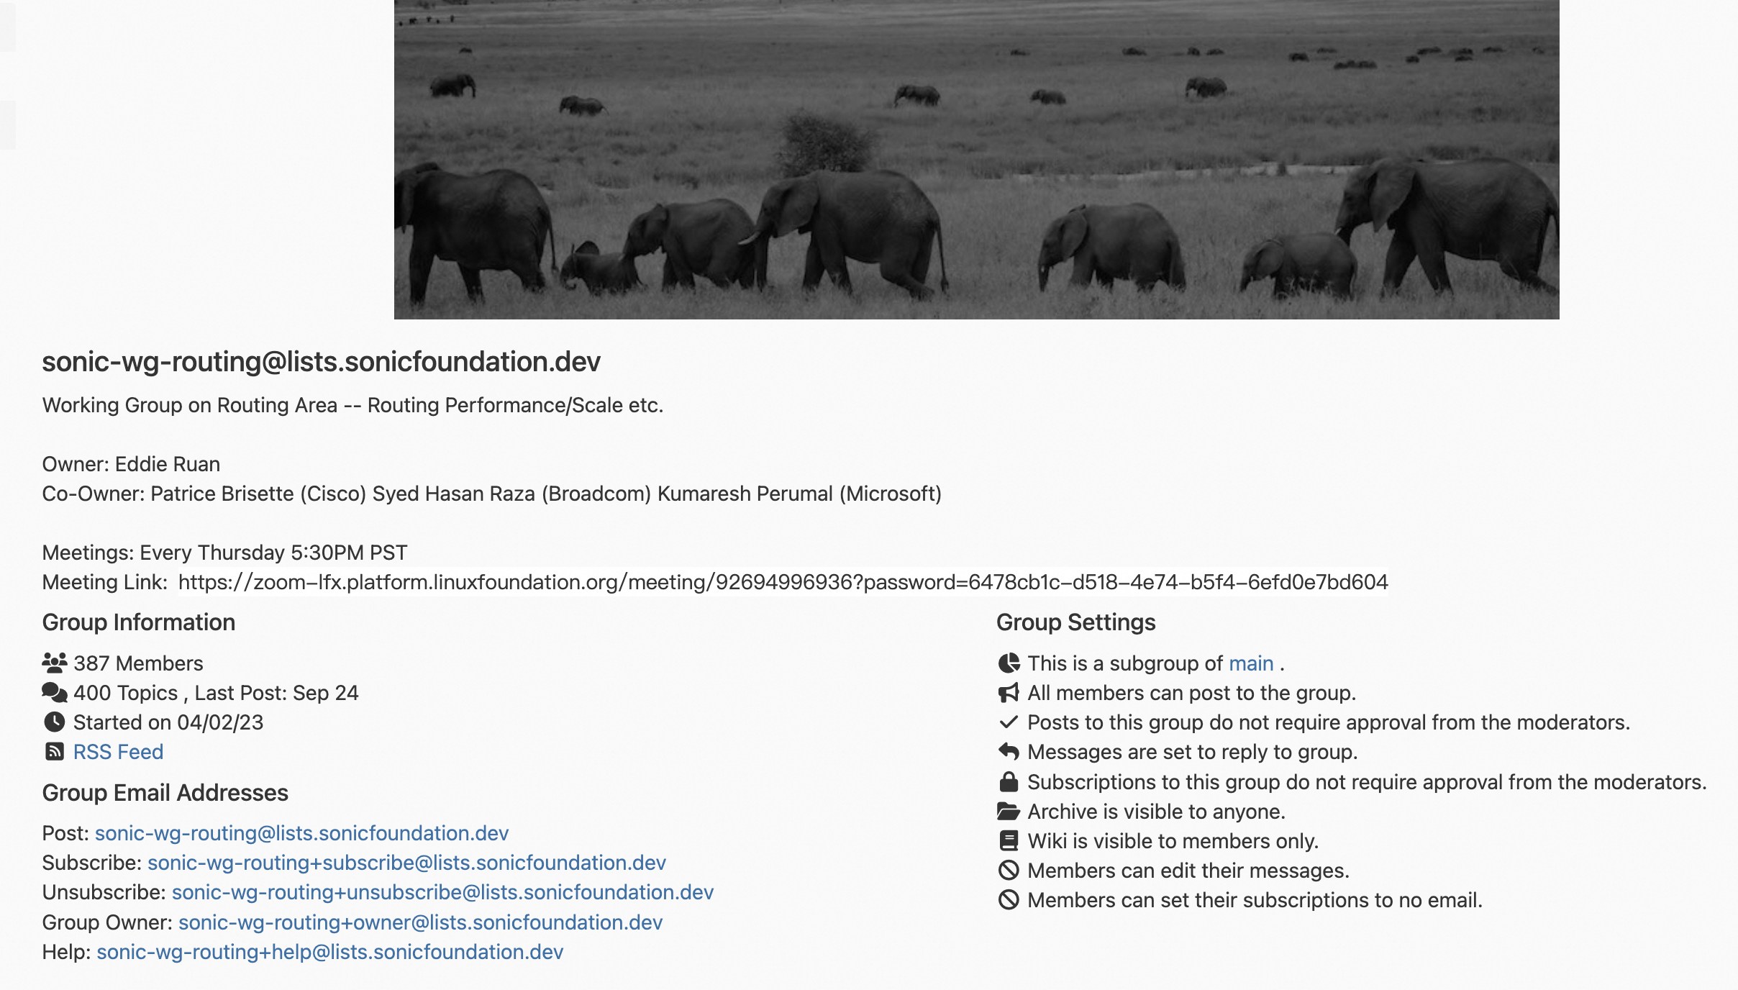

Slide 44
Call for Actions
Participate
Subscribe to mailing list
Join the WG meeting and discussions
Contribute
Participate to challenges, use-cases & new ideas
(Update Incoming Topics)
HLD & Code PRs
Reviews
https://lists.sonicfoundation.dev/g/sonic-wg-routing

